Slide 1
RS232 Simulation
By Kashyap Rao and Ryan Obuchon

Slide 2
Goals
Design an RS232 simulator
1
Implement features like clock drift, non return to zero encoding, variable data length, and start and stop bits
Plot and display results
2
Display the simulated transmission line along with an ideal clock signal.

Slide 3
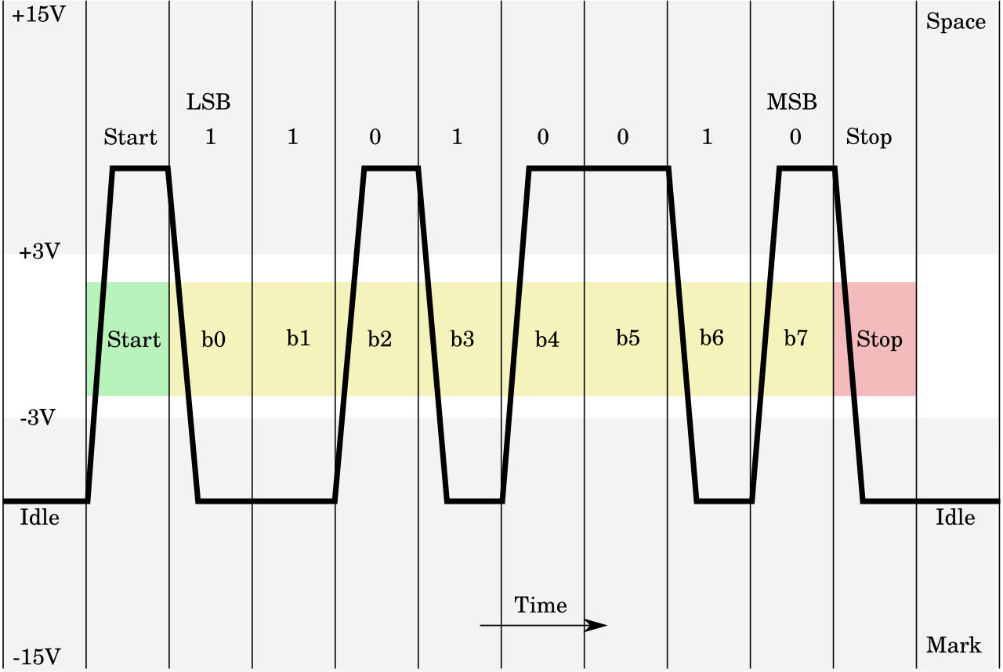
Overview: What is RS232?
RS232 is a communication protocol standard used in IO devices and industrial technology(PLCs).
It is a full duplex communication protocol that uses positive and negative voltages.
Device 1 TX -> Device 2 RX, Device 1 RX -> Device 2 TX

Slide 4
Real world use cases
Allows testing and verifying serial communication without physical hardware
Visualizes actual RS-232 waveforms, including bit timing, polarity, and idle states
Helps identify issues like incorrect baud rate, framing errors, or wrong bit order
Useful for embedded and firmware debugging when oscilloscopes or analyzers aren’t available
Enables easy comparison of multiple transmissions on the same plot
Provides an educational tool for understanding asynchronous serial encoding
Supports early development before the electrical interface is fully designed or built

Slide 5
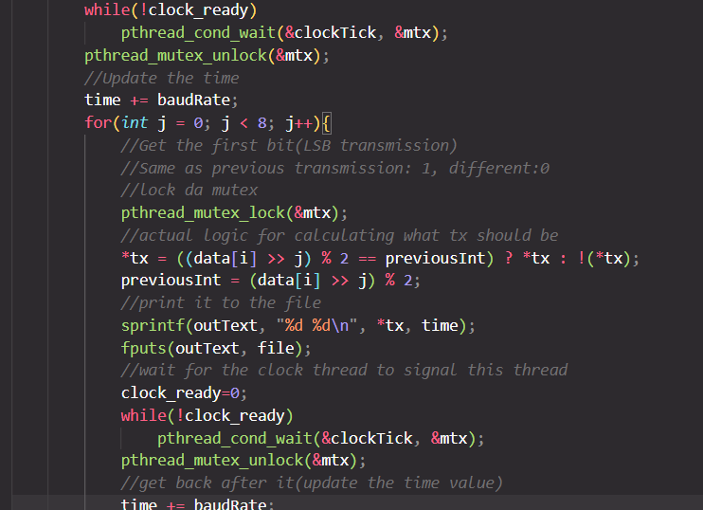
Program Features
Generates an ideal clock file to use as a reference measurement
Implements randomization of a 9600bps clock to simulate clock drift due to noise
Simulates Non Return to Zero Encoding for Least Significant Bit Transmission.

Slide 6
Python plotter
Reads simulation output files containing logic level + timestamp pairs
Converts logic levels into actual RS-232 voltages (+10 V / –10 V)
Automatically inserts idle negative voltage before and after the data
Adds small rise/fall slopes to transitions to mimic real physical signals
Converts raw timestamps into milliseconds for readable timing
Supports multiple files plotted on the same axes for visual comparison
Uses different colors and line styles (e.g., dashed for second file)
Produces a clean, accurate waveform that reflects true RS-232 behavior

Slide 7
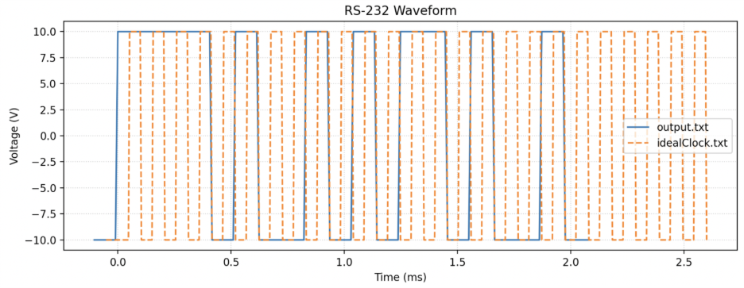

Slide 8
Limitations and Future Improvements
Simulator does not model analog effects such as noise, ringing, overshoot, or line capacitance
Only supports a fixed baud rate (9600 bps) and a single encoding format (NRZ, LSB-first)
No support for parity bits, variable stop bits, or multi-byte streaming with proper framing
Clock drift is randomized but does not emulate full physical oscillator behavior
Python plotter does not decode bytes or validate data integrity—visual only
Simulation focuses on TX behavior only; no feedback or error handling from a receiver side

Slide 9
Conclusion
Successfully simulated RS-232 signaling behavior, including NRZ encoding and realistic timing drift
Demonstrated how logic-level data translates into physical voltage waveforms on an asynchronous serial line
Verified correctness of transmission patterns through visualization, reducing reliance on physical hardware
Python plotter enabled fast comparison of multiple signal outputs, improving debugging and validation
Showed how simulation tools can model real-world communication challenges such as clock drift and rise/fall times
Provided an educational, accessible method for understanding serial communication at both the logical and electrical levels
Overall, the project delivered a practical and flexible framework for analyzing and validating RS-232 communication systems

